Slide 1
MIS581 - Portfolio Project
Telecom Churn Prediction
CSU Global
Jordan LaCerte
Notes:
Hello,
I am Jordan LaCerte and this is the presentation of my portfolio project for MIS 581. This project is a telecommunication churn prediction project that involves predicting if a customer will churn using machine learning algorithms.

Slide 2
Churn information
Churn is when a customer leaves the service that the company is providing
Monthly loss from churn, per carrier is $65M - Aditya Kapoor
Acquiring a new customer is 50x more expensive than retaining customers \
In order to combat churn we must predict who will churn
How to predict churn?
Classifier models to predict who will churn
Random Forest and Logistic regression seem very popular
Use Data set from Kaggle
Notes:
Customer churn is defined as “when a customer is no longer satisfied with the service or finds an alternative to that service and ends up leaving, aka churning, from the company” Essentially, when a customer no longer satisfied with the service and leave that is churn.
According to Aditya Kapoor of NYU’s stern school, “Monthly loss from churn, per carrier is $65M” which can end up being incredibly expensive in the long run if a company is not able to predict churn and take preventative measures against churn.
Additionally, according to a Canadian study, it appears that retaining a customer is almost 50 times cheaper than acquiring a new customer (telecoms.com, 2018) which makes it important to look at reducing customer churn and retaining a company’s current customer base. This is due to a variety of factors including marketing costs, overhead costs, and any deals or discounts that are sent to customers.
Essentially, in order to combat churn we must be able to predict who will churn and if possible why they churned. This led to some preliminary background research and it appears that one of the most popular tools is a random forest model. One was used by both Abdelrahim Kasem Ahmad at the Journal of big data (Abdelrahim Kasem Ahmad et all. 2019) and by Irfan Ullah of the University of Islamabad (Irfan Ullah et all. 2019). An additional classifier will be used and it will be a logistic regression for its simplicity and effectiveness in predicting events like churn
In order to do this we must find data that we will be able to generate machine learning algorithms for. This data set will be from Kaggle and explained further in the next slide.

Slide 3
Literature Review
Need to understand what people have done before
Kiran Dahiya and Surbhi Bhatia - provides information on churn and random forest and logistic regression
Abdelrahim Kasem Ahmad et al - churn background and random forest information
Irfan Ullah et al - methodology for random forest and how it competed against other models
Hemlata Jain et al - feature selection, logistic regression, evaluation, and comparison to other models
Notes:
The first step to look at for studying literature on the topic of churn in the telecommunication industry is to understand the domain of telecommunication and churn. That is why the first piece of literature comes from Kiran Dahiya and Surbhi Bhatia of the computer science departments of Manav Rachna College of Engineering and Echelon Institute of Technology respectively. In their work, Customer Churn Analysis in Telecom Industry they go over some background information on what churn is and what companies have been doing about churn, they then go into using data mining and machine learning techniques to tackle churn (Kiran Dahiya and Surbhi Bhatia 2015). This paper provides two things; domain knowledge and previous work. The domain knowledge comes from the background on churn and company’s attempts to tackle it while the previous work includes their use of machine learning like random forest and logistic regression to build a model to help predict churn. This will show what a previous project had done and these can always be improved and applied to different data sets.
The next work to look at is to get a similar understanding of what has already been done. In a project done by Abdelrahim Kasem Ahmad et al in their Customer churn prediction in telecom using machine learning in big data platform, they discuss what companies have previously done about customer churn (A. Ahmad et al 2019). They discuss the previous options companies used and the importance of combating churn (Ahmad 2019). This shows the importance of understanding churn while also giving details about how machine learning models like random forest were used and how it performed at predicting customer churn.
The next piece of literature comes from Irfan Ullah et al titled A Churn Prediction Model Using Random Forest: Analysis of Machine Learning Techniques for Churn Prediction and Factor Identification in Telecom Sector. This paper goes into detail about the previous machine learning models that have been applied to telecom churn issues and how they have historically performed; the paper then performs their own analysis of this phenomena (Irfan Ullah et al 2019). This is relevant as it provides more background on the various classifiers and it shows the methodology that one group used for their model which can be used in this project. Additionally, knowing how a random forest usually stacks up against other models can give insight if the data set is different or if the model needs additional adjustments.
The final literature deals with the other model, the logistic regression model. This comes from Hemlata Jain et al, in their Churn Prediction in Telecommunication using Logistic Regression and Logit Boost. This paper has a similar use case as the last one, it provides a background of the previous attempts to tackle the problem of churn, things like feature selection dilemmas, and finally how a logistic regression model with churn in mind was built, executed, and finally evaluated compared to another model (Hemlata Jain et al 2019). This paper gives insight on how logistic regression is actually used, implemented, and evaluated which will be invaluable over the course of the project.

Slide 4
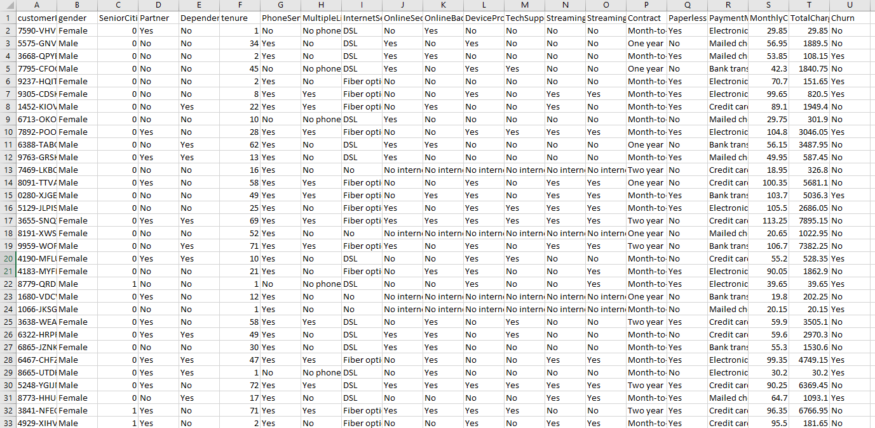
Data Set
Churn data set from Kaggle originally based on data from IBM.
21 columns, 7,044 Rows
Data include demographic data, package data, internet service data, tenure, churn, and other variables
Data set chosen for robust amount of features to select from
Notes:
The aim of this project will be to better predict customer churn based on the Kaggle dataset “Telco Customer Churn” found at https://www.kaggle.com/datasets/blastchar/telco-customer-churn?resource=download.
Originally found from IBM, this dataset seems to be fairly robust with 7,044 entries and 21 columns including things like customer data type, total bills, what type of internet service, tenure, and many more factors in the data set. Additionally, by using various machine learning models like Random Forest coupled with statistical methods like t-tests or chi-squared tests this project will attempt to find significant features and predictors for churn that can be used later to help predict churn. The main aims of this project will be to create a robust and harmonious machine learning model that will be able to predict if a customer will churn as well as performing feature selection to get a better understanding of what the important factors are for keeping customers. While predicting churn is the primary goal, the second goal will try to be feature selection and feature engineering to try and determine important features and predictors of churn. This is why this project will feature overall bagging models like a random forest and a logistic regression model to determine the importance of features (Brain John, 2022).

Slide 5
Research Questions
“A good research question is assessed based on its influence on a specific field or broader business, its influence on management practice, whether it is event-specific and time-sensitive, and whether the contribution is generic or context-specific” (Siah Hwee Angm 2014).
Two main questions: who will churn and why will they churn?
Hypothesis Testing is next
Ho: we will not be able to find a statistically significant classifier between the random forest and logistic regression models. The alternative hypothesis would be, Ha: the random forest or logistic regression model was able to significantly predict whether a customer would churn or not based on the data set.
Ho: there will be no significant predictors and features to predict customer churn. The alternative would be: Ha: there are significant features that must be analyzed to predict and understand customer churn better.
Notes:
The next step is to develop the research questions and hypothesis that we will be testing for our machine learning model.
According to Siah Hwee Ang, the Chair in Business in Asia, Victoria University of Wellington, “A good research question is assessed based on its influence on a specific field or broader business, its influence on management practice, whether it is event-specific and time-sensitive, and whether the contribution is generic or context-specific” (Siah Hwee Angm 2014).
Currently, there are two main questions, who will churn and why will they churn? The first question is essentially if we will be able to generate a satisfactory model to be able to predict customer churn. The second question is using our machine learning algorithms to identify the key features and wants for customers.
According to Dr. Frances Chumney of the University of West Georgia, “Step 1: State the Hypotheses Null Hypothesis (H0 ) in the general population there is no change, no difference, or no relationship; the independent variable will have no effect on the dependent variable[...]Alternative Hypothesis (H1 ) in the general population there is a change, a difference, or a relationship; the independent variable will have an effect on the dependent variable.” (Frances Chumney).
Ho: we will not be able to find a statistically significant classifier between the random forest and logistic regression models. The alternative hypothesis would be, Ha: the random forest or logistic regression model was able to significantly predict whether a customer would churn or not based on the data set. In order to test these hypotheses we will have to create the two models, logistic regression and random forest, and analyze how well they perform when we perform validation tests on the models where we will look at things like accuracy, recall, precision, and all the other marks of models. The second set of hypothesis we will have will be related to feature selection. The first is that Ho: there will be no significant predictors and features to predict customer churn. The alternative would be: Ha: there are significant features that must be analyzed to predict and understand customer churn better.

Slide 6
Methodology
Jupyter Notebook environment for Python
Packages - numpy, pandas, seaborn, matplotlib, sklearn
Generated logistic regression and random forest after cleaning data
Evaluated models based on multiple factors including AUC, f1, etc.
Notes:
In order to perform this analysis we first had to decide on a tool. That was Python, specifically the Jupyter notebook environment because of familiarity and ease of use.
The main packages that were used were numpy for arrays, linear algebra, and math. Pandas was used as it is one of the leading data science packages and data manipulation packages. Seaborn was used to enhance python’s natural ability to make charts to generate pleasing visuals. Matplotlib was also used for data visualization and generating graphs. Finally sklearn was used as the basis for the machine learning algorithms.
The overall methodology was to upload and clean the data. After the data was malleable and useable I generated logistic regression and a random forest model based off the data set. After running the algorithms, I then evaluated them based on multiple factors including AUC, f1 score, accuracy, precision, recall, and more.
After evaluating I was able to generate the results shown on the next slide/

Slide 7
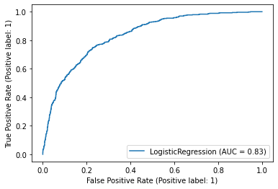
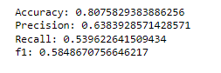
Results (Logistic Regression)
Notes:
The main results of the predictions are shown on the following two slides. This is the evaluation of the logistic regression classifier. As we can see, all the classic measures are good and above 0.5 while the AUC is also good at 0.83 which shows that this is a robust model based on the data that is has been trained on. This means we can reject our first null hypothesis and presume that we may have a good classifier on our hands. One reason that the classifier may not be better is due to the nature of churn, most customers will not churn all at once so it is a little more difficult to be extremely precise and have good recall.

Slide 8
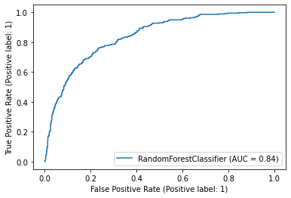
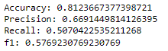
Results cont. (Random Forest)
Notes:
This is the evaluation of the random forest classifier. As we can see, all the classic measures are good and above 0.5 while the AUC is also good at 0.84 which shows that this is a robust model based on the data that is has been trained on. This means we can reject our first null hypothesis and presume that we may have a good classifier on our hands. The main issue with the random forest is that the recall is not as good which may suggest that there could be issues with false positives and should be evaluated further. However, as the rest of the variables are still good we can say that it is a good predictor based on the data set.

Slide 9
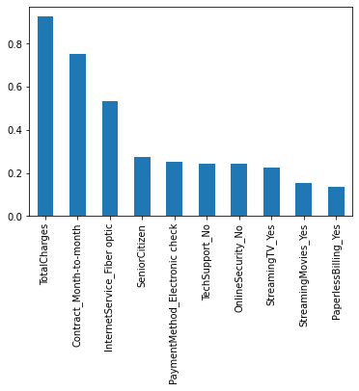
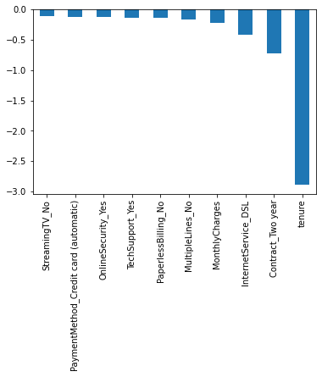
Feature Selection (Logistic Regression)
Notes:
The second part of the results is based on the second hypothesis: can we find any significant features. One issue that we had with this is that sklearn does not provide chi-square or other significance testing abilities. While that is an issue, we can still look at the logistic regression feature selection and random forest selection to understand more. As we can see from the logistic regression feature importance charts, we can see that the most important predictors of churn are the customer contract and total charges while the best predictor or staying is if they have a long term contract or they have been with the company for a while. This suggests that it may be more beneficial to prompt people to get a longer deal or perhaps look further into pricing to see if it is needed.

Slide 10
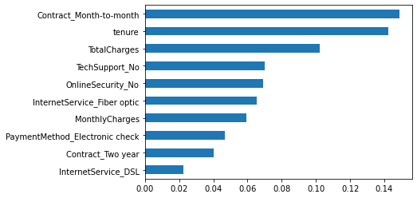
Feature Selection (Random Forest)
Notes:
The feature selection from the random forest model confirms that the most important things to predicting customer churn are the contract detail, payments, tenure, and then features come second like fiber optic and DSL. This is interesting and may suggest that the service is secondary and the pricing is first for customers which can suggest that people can get discounts or some other way to keep customers with the telecom company. Additionally, with the confirmation from both algorithms, we can reject the null hypothesis and we may have discovered important features for customers.

Slide 11
Results cont.
Logistic Regression > Random forest
All same, f1 a little higher
Both predict churn well and showed important features
Money and time seem to be the most important, other features are nice but not as significant
Predicting churn and combating it is next step
Notes:
With the creation of these two models, I would recommend the logistic regression model first as it was more robust and less susceptible to false negatives compared to the random forest model. Both models are strong predictors however and depending on the size of the future data sets random forest may be more beneficial.
Additionally, these models were able to show certain features that the models heavily relied on and considered important. These were based mainly on customer time with tenure and total charges but the customer contract type mattered as it appears that customers with month to month contracts may be more likely to churn as opposed to customers with more skin in the game. Additionally, while they may not be as significant it does appear adding things like fiber, DSL, and tech support can get customers to stay longer but that is not conclusive.
The models that were created are able to predict customers who will churn and are able to identify the important features in customer churn.

Slide 12
Recommendations
More data (7k is not a lot)
Try and find more features with more data
Implement model and see how it performs on future and live data to see if it needs adjusting.
Notes:
For future projects the main recommendation would be to get more data. While this was a robust data set, anything under a million rows is still small and may not give as accurate or as wide a range of a picture. This can help the models become more accurate and have better overall numbers as there is more data to study. The second thing would be to dive deeper into feature selection and see if there are more features that could be added on to study as it appears that there are not too many significant features to study. By doing this the next steps could be to implement one of these models to predict customer churn and use that to help better get customers to stay with the company based on the important features. However, it must be said that some people are nervous about sharing all their data so a pilot group could be used to generate a new model and predict based off that.

Slide 13
References
Ang, S. (2014). The research question. SAGE Publications Ltd, https://dx.doi.org/10.4135/9781473909694
Ahmad, A. K., Jafar, A., & Aljoumaa, K. (2019). Customer churn prediction in telecom using machine learning in Big Data Platform. Journal of Big Data, 6(1). https://doi.org/10.1186/s40537-019-0191-6
Churn is breaking the telecoms market: Here's how to fix it. Telecoms.com. (2018, September 27). Retrieved from https://telecoms.com/opinion/churn-is-breaking-the-telecoms-market-heres-how-to-fix-it/
Chumney, F. (n.d.) HYPOTHESIS TESTING Retrieved from https://www.westga.edu/academics/research/vrc/assets/docs/HypothesisTesting_HANDOUT.pdf
Dahiya, K., & Bhatia, S. (2015, September). Customer churn analysis in telecom industry. In 2015 4th International Conference on Reliability, Infocom Technologies and Optimization (ICRITO)(Trends and Future Directions) (pp. 1-6). IEEE.

Slide 14
References Cont.
Hemlata Jain, Ajay Khunteta, Sumit Srivastava, Churn Prediction in Telecommunication using Logistic Regression and Logit Boost, Procedia Computer Science, Volume 167, 2020, Pages 101-112, ISSN 1877-0509, Retrieved from https://doi.org/10.1016/j.procs.2020.03.187. (https://www.sciencedirect.com/science/article/pii/S1877050920306529)
John, B. (2022, November 14). How to implement customer churn prediction [Machine Learning
Kaggle. (2018, February 23). Telco customer churn. Kaggle. Retrieved, from https://www.kaggle.com/datasets/blastchar/telco-customer-churn?resource=download
Kapoor, A. (2017). CHURN IN THE TELECOM INDUSTRY – IDENTIFYING CUSTOMERS LIKELY TO CHURN AND HOW TO RETAIN THEM. Retrieved, from https://wp.nyu.edu/adityakapoor/2017/02/17/churn-in-the-telecom-industry-identifying-customers-likely-to-churn-and-how-to-retain-them/
Ullah, I., Raza, B., Malik, A. K., Imran, M., Islam, S. U., & Kim, S. W. (2019). A churn prediction model using Random Forest: Analysis of machine learning techniques for churn prediction and factor identification in telecom sector. IEEE Access, 7, 60134–60149. https://doi.org/10.1109/access.2019.2914999

